Slide 1
The Ethics of Biology and Technology
Jeremy Holloway
CPSC 2910 September 29th, 2017
Notes:
This template is in wide-screen format and demonstrates how transitions, animations, and multimedia choreography can be used to enrich a presentation.

Slide 2
Topics to be discussed
What is body hacking?
What are some common types of body hacking?
What are ethics?
Dangers of body hacking
Case Study: Three Square Market

Slide 3
Wait, did you say cyborgs?
RFiD Chips
Neil Harbisson
He’ll Be Back
Not quite, but that doesn’t mean some aren’t trying

Slide 4
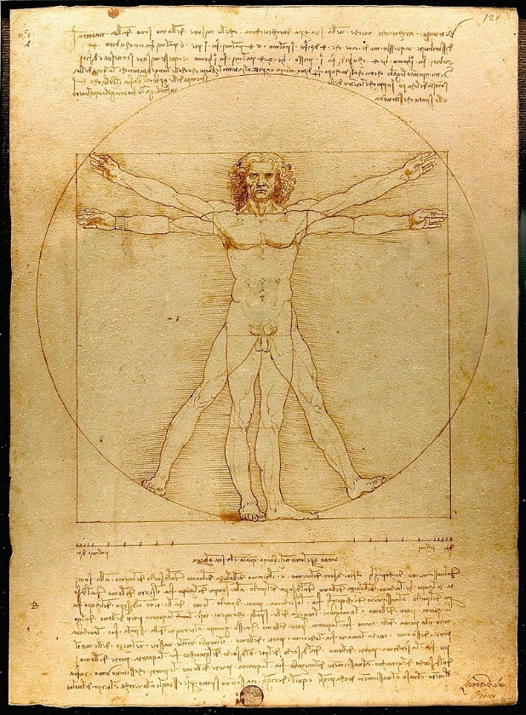
What are some current types of body hacking?
Electromagnetic field, finger implants
Sonar, implant or wearable
Compass, wearable
Night vision, injection
Hear Wi-Fi, hearing aid
RFiD Chips, implant
Headphones, implant
Hear colors, implant
Shock stimulation

Slide 5
What are ethics?
Ethics are the gray area between what is right and what is legal. Implants are not always installed or designed by medical professionals. The medical field is often at odds with body hacking since it does not provide a quantitative value for doctors to base the risk assessment from.

Slide 6
Dangers of hacking
Some devices require precise surgical placement to be effective
Malpractice insurance won’t cover unorthodox procedures
Devices not encapsulated in the proper materials can pose a serious health hazard
Magnetic devices can cause unintended side effects, like wiping credit cards, storage devices, etc.

Slide 7
Case Study: Three Square Market
A Wisconsin based technology company is offering a voluntary microchipping program for its employees. A ring with an embedded chip is also offered as a less invasive option.

Slide 8



What does the chip do?
Office entry
Paying for food
Computer access
Personal belonging access (Lockers)

Slide 9
What’s the problem?
Data storage
Tracking capability
Health concerns
Future expansion
Removal process
Ethics

Slide 10
The end result
Over all, the program received wide praise amongst the staff and the company implanted 50 of the 80 employees. All of the recipients are still happy with their decisions and no one has suffered a complication.

Slide 11
Questions?
Please ask any questions
Thank you for your time!

